Slide 1
Few questions before we start..

Slide 2
Swappi AI
The AI platform for ticket swapping.
© 2023 Swappi AI, Israel. All rights reserved.

Slide 3
Lidan Danino
Niv Netanel
CEO
CTO
Our Team
Advisor board:
Alex lyhovez
Mark Israel

Slide 4
The pain
The solution
Time!
Direct communication.
Where to post an ad?
Follow lots of sources.
After the Swap, needed to inform the ticket company and change the information.
Saving Time!
Fully automated platform using AI bot.
Convenient and cost-effective solution.
Greater exposure.
Swappi AI

Slide 5
Swappi AI added value to our users
01
02
03
AI services
Bidding auction
Loyalty program

Slide 6
Business model
First level – POC/MVP | Second level
AI services
Advertisements
AI
Serving fee
Collaborations
Memberships

Slide 7
01
Planning for POC
Current Traction
Data gathering &
Development
02
03
Finish POC &
Reaching investors
04
MVP

Slide 8
What we’ve done so far?

Slide 9
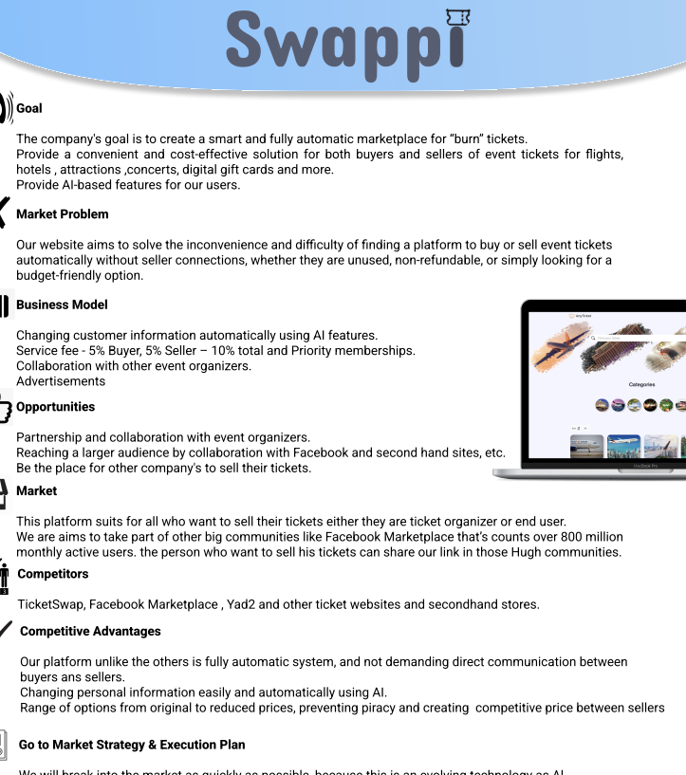
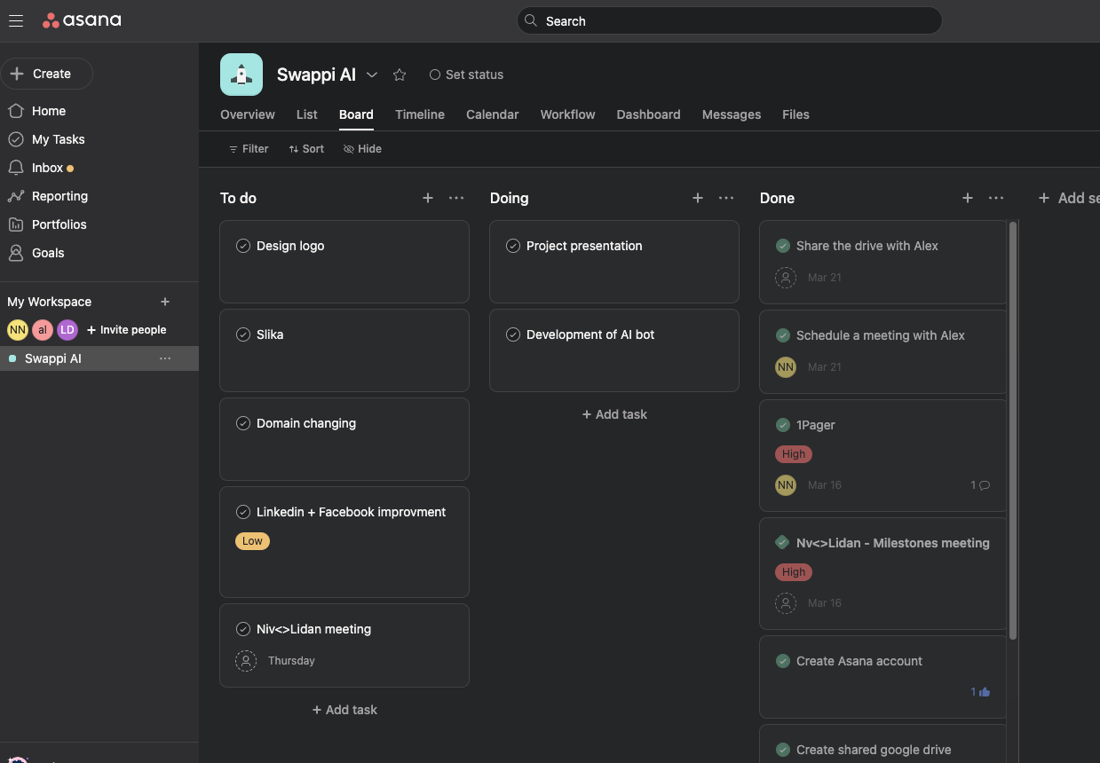
One Pager

Slide 10
Customer journey
User-Buyer

Slide 11
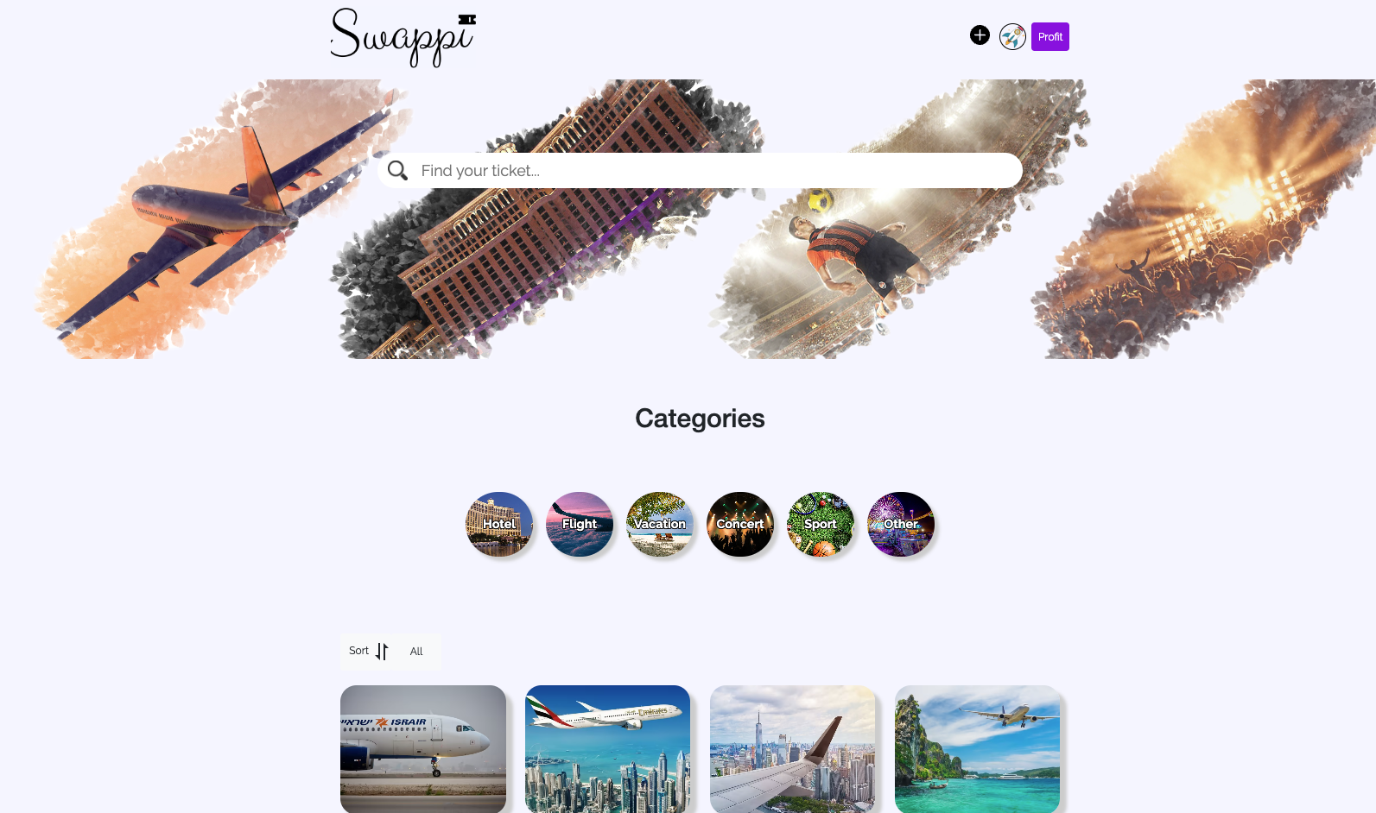
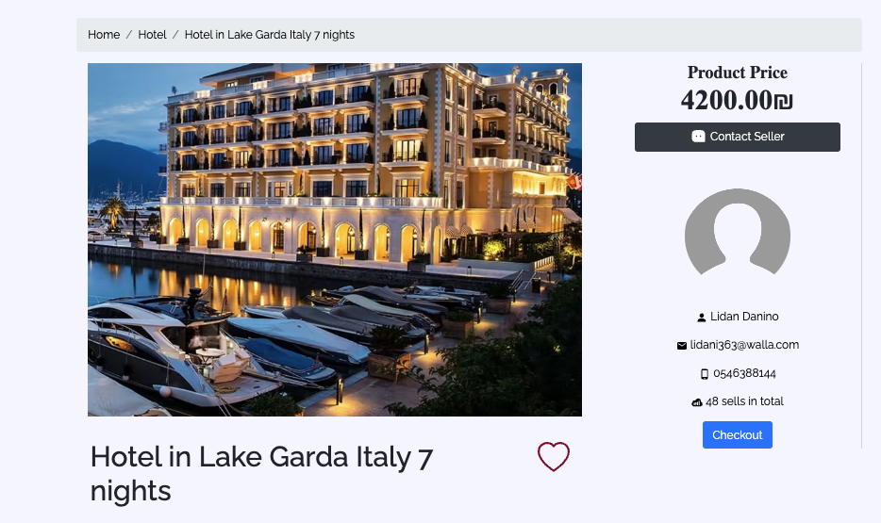
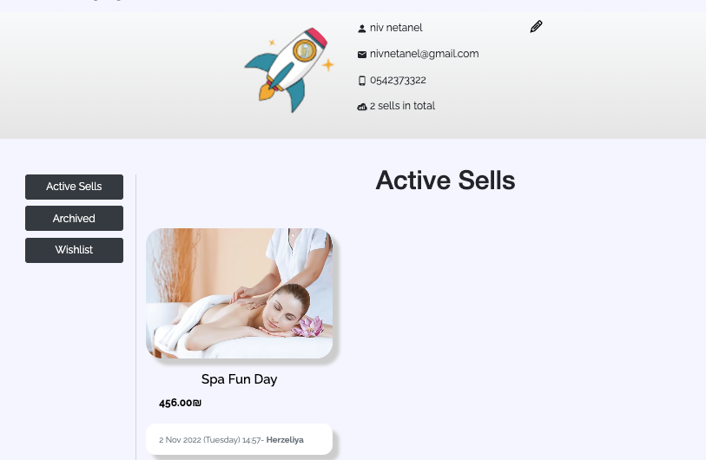
Swappi AI

Slide 12
Thank You
Swappi AI
© 2023 Swappi AI, Israel. All rights reserved.

Slide 13
Contact Us
We would love to hear from you
Lidan Danino, +972-546-388142.
Lidan05463@gmail.com.
Niv Netanel, +972-542-373322.
Nivnetanel@gmail.com.
https://swaappi.netlify.app/

Slide 14
Go to market strategy
01
Investors
We will break into the market as quickly as possible because this is an evolving technology as Al.
In the first stage, meet investors and at the same time we’ll aim at social media marketplaces because it has the highest percentage of users.
Massive advertisement and we look forward to expanding beyond social media.
02
social media
marketplaces
03
Massive advertisement

Slide 15
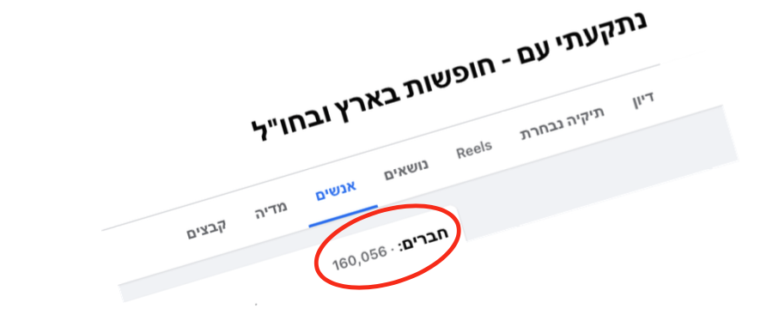
Market
01. Facebook Marketplace
Count’s over 800m monthly active users
02. Tickets organizers
03. Global market

